Slide 1
Keyword Extraction
First presentation
ML presentation

Slide 2
1. Definitions
Given a document, the algorithm will find the key phrases that represent the main topics and ideas of the document
The data structure of each sample: a text document and a list of keyphrases
Keyphrases can be either present or hidden in the document

Slide 3
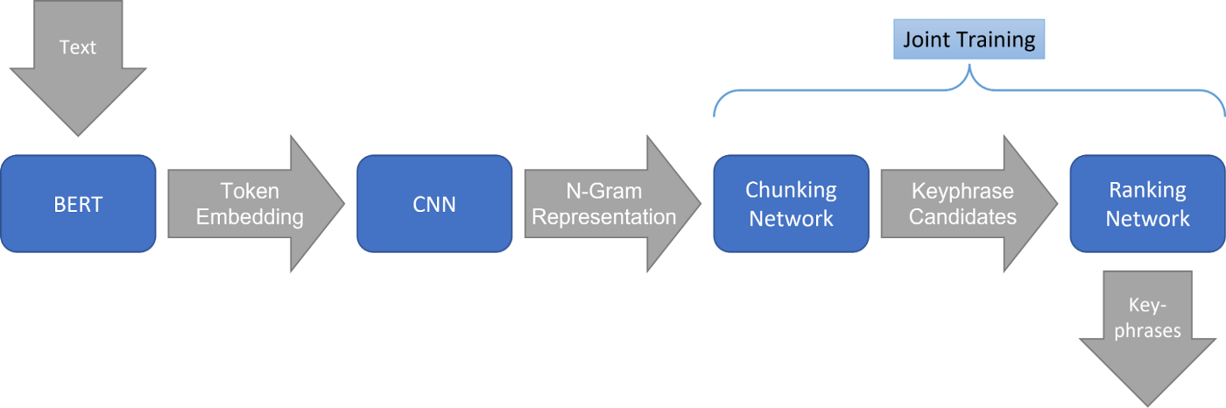
2. Joint-KPE results reproduction
Description of Joint - KPE
(batch_size x length_tokens)
(batch_size x length_doc)
(batch_size x n_gram_num x 512)
(batch_size x n_gram_num)
(batch_size x n_gram_num)
Score of each n-gram represents the probability of being keyphrase
Notes:
My first step of my stage
Get from the original code of paper
By the time, the code is changing alot

Slide 4
Advantages
Current SOTA on 2 big datasets: openkp (148124 docs in science fields) and kp20k (570000 docs in news fields)
Disadvantages
Have limit on the length of document -> performs badly on long documents ( > 512 tokens)
Can not extract the hidden keyphrases
Need to fix the number keyphrase candidates at the output

Slide 5
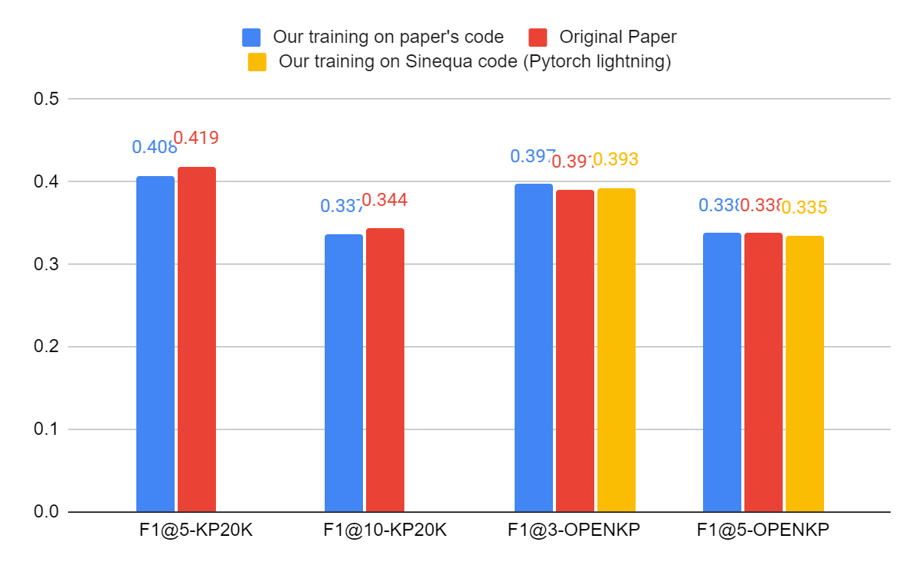
Result of reproduction

Slide 6
3. Pipeline and analyse on 4 free commercial used datasets
Data pipeline
Raw data from git
Pivot Format
Preprocessed
Input data
url
text
keyphrase
Url
Token
n_gram and position
label
Url
preprocessed text
keyphrases present in doc
Keyphrases positions
Notes:
One of the most important thing is creating a data pipeline, from source, to input data. As we have some differents dataset, I create a script to get dataset always from git. After that, a script is used to transform the data to pivot format. The pivot format has only 3 thing : the id, the text, with full of information, and the keyphrase. To be clear, this text is the text from raw data, it is not filtered by punctuation or crop. Keyphrase is include present and hidden key. Evaluating another algorithm in the future is the reason I keep as much as impossible the information of data. In the term of preprocessing, text data will be preprocessed, for example number -> digit, filter punctuation, only have present keyphrase, finding the position of each keyphrase. Dataset at preprocesis managed by dvc, as we can follow the version, or the change of prepro data, in case we change the way we preprocess. Normally, we can feed the preprocessed data to the model. However, the data from preprocessed to input format get a lot of time, that is why I insert a step from preprocessed data to input data. Tokenization for bert, and finding all positions of all n-gram is the reason of consuming alot of time. Having already the input format for train data help us reduce the time for each step.

Slide 7
Data analysis on the four dataset for commercial use
 | number document | average length document | average length of keyphrase | average number of keyphrase
inspec | 2000 | 162 | 2.705 | 6.365
semeval17 | 493 | 492 | 2.2 | 14.8
kptimes | 260000 | 921 | 1.5 | 2.703
pubmed | 500 | 3992.78 | 1.4 | 5.835
After analyzing 4 dataset, we can conclude that:
There is a big difference between the number of documents for each dataset
The length of present keyphrase is not quite big, so we can limit the maximum length of n-gram to 5
Kptimes and pubmed dataset have long document (> 512 words)
Based on the average number of keyphrases, I choose different main metric for each dataset: F1@10 score for inspec, semeval and pubmed; F1@5 score for kptimes
Notes:
By the result about commercial free use dataset, we
Inspec consists of 2,000 abstracts of scientific journal papers from Computer Science collected between the years 1998 and 2002
SemEval2017 consists of 500 paragraphs selected from 500 ScienceDirect journal articles, evenly distributed among the domains of Computer Science, Material Sciences and Physics
million citations for biomedical literature from MEDLINE, life science journals, and online books

Slide 8
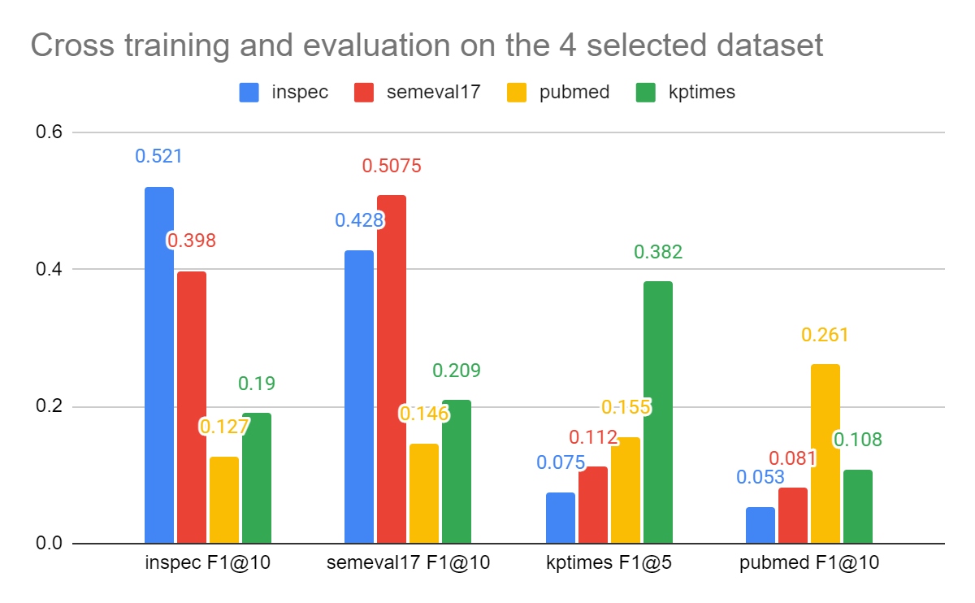
3. Results on 4 free commercial used dataset

Slide 9
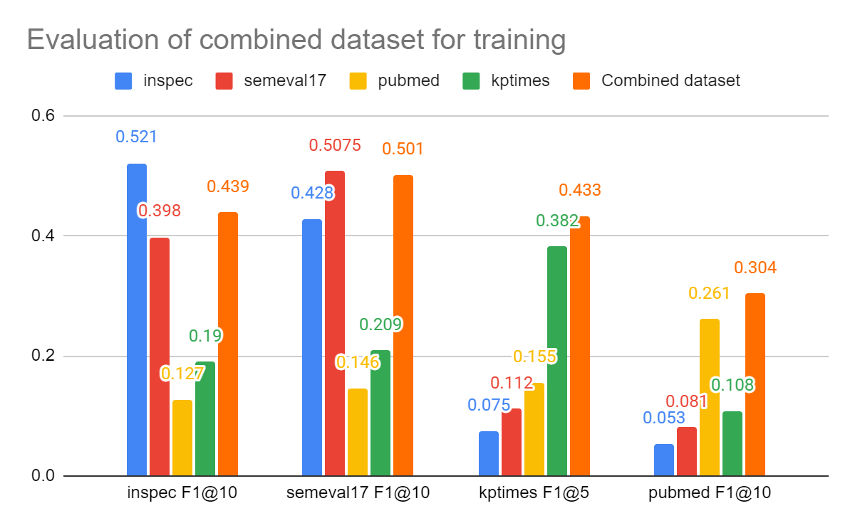
Results on combining 4 free commercial used dataset

Slide 10
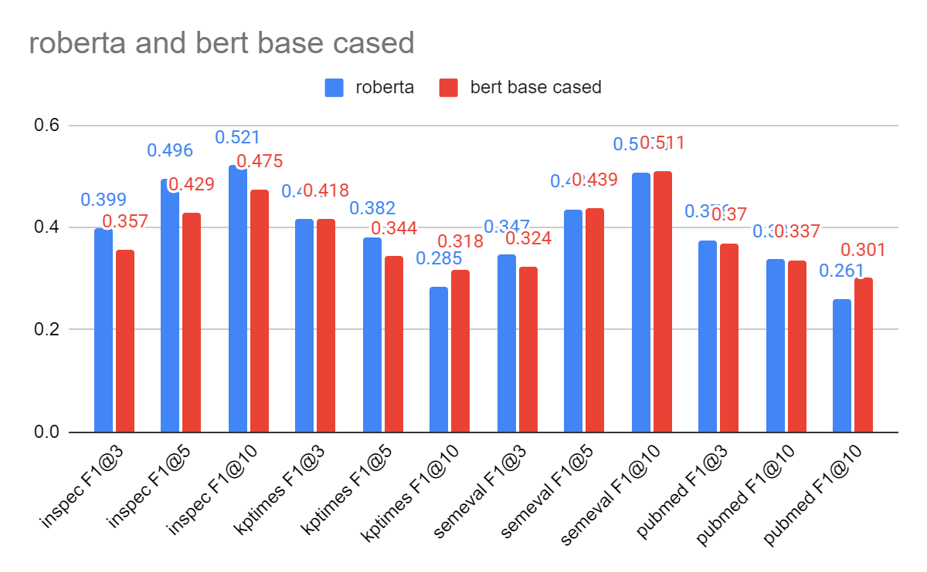
Compare 2 base language model

Slide 11
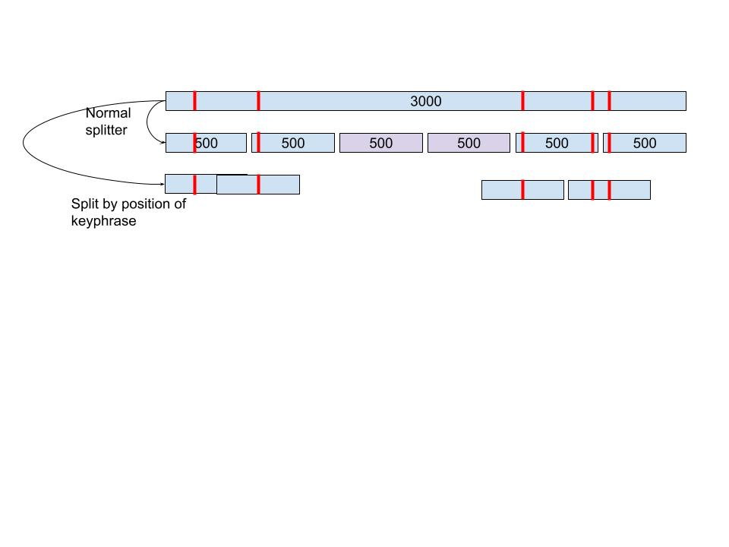
2 ways of splitting long documents ( > 512 tokens)
Split using splitter of Sinequa/Common:
Disadvantages: keyphrases in the beginning or at the end of of document don’t contain enough contextual information
Split using the position of keyphrase
Disadvantages: Model could consider that only n-gram in the middle of the passage can be keyphrase

Slide 12
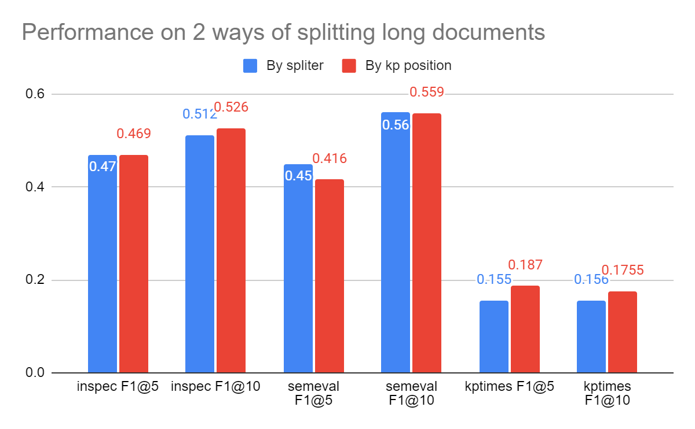
Compare 2 ways of splitting long dataset
To compare the performance of splitting dataset, I used 2 strategies to have 2 versions of data pubmed (normal splitter and splitting be position). Then, I concatenated each one with inspec and semeval with have only short dataset
To evaluate, I inference 2 models on inspec, semeval and kptimes (with only short document)

Slide 13
3. Implementation
Data pipeline.
Replace normal dataset to iterable distributed dataset
Replace pytorch to pytorch lightning framework, in order to run on 8 cores TPU of colab

Slide 14
4. Problem and future work
Try to test on big dataset (kptimes after splitting long document)
Apply other ranking metrics, reduce deep language model size
Apply some preprocessing data
Find a post processing to deal with long document
Multilingual translation and training
Reading new paper on Keyphrase extraction
Integration

Slide 15
Thank You!
with the most complete Enterprise Search, ever.

